Slide 1

Path Loss & Shadowing
Wireless Communication: Assignment 2

Slide 2

Overview of Assignment
Understand how signal power reduces with distance.
Implement MATLAB code to compute:
Received Power (Pr)
Path Loss (PL)
Compare behaviour at different frequencies.
Add shadowing effect using log-normal random variations.

Slide 3
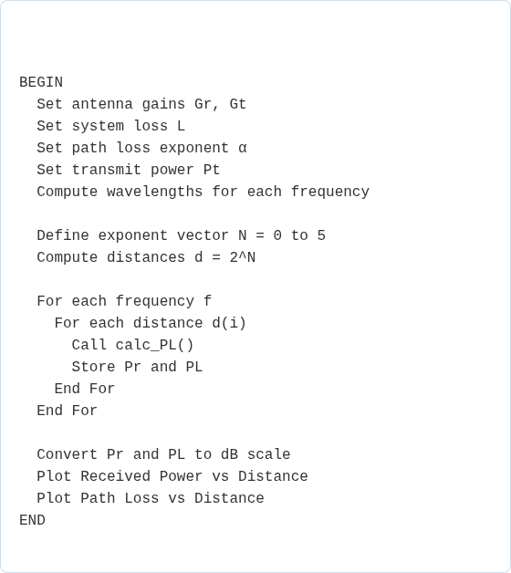
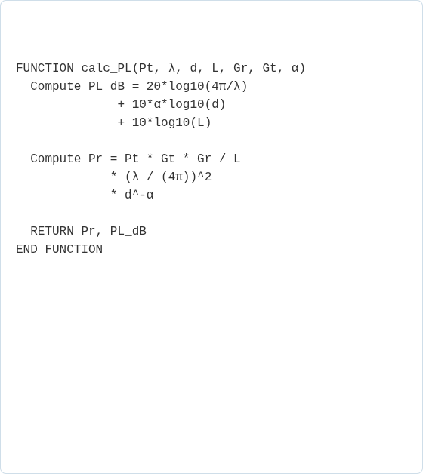

Path Loss Model: Pseudocode
Main MATLAB Script
calc_PL Function

Slide 4

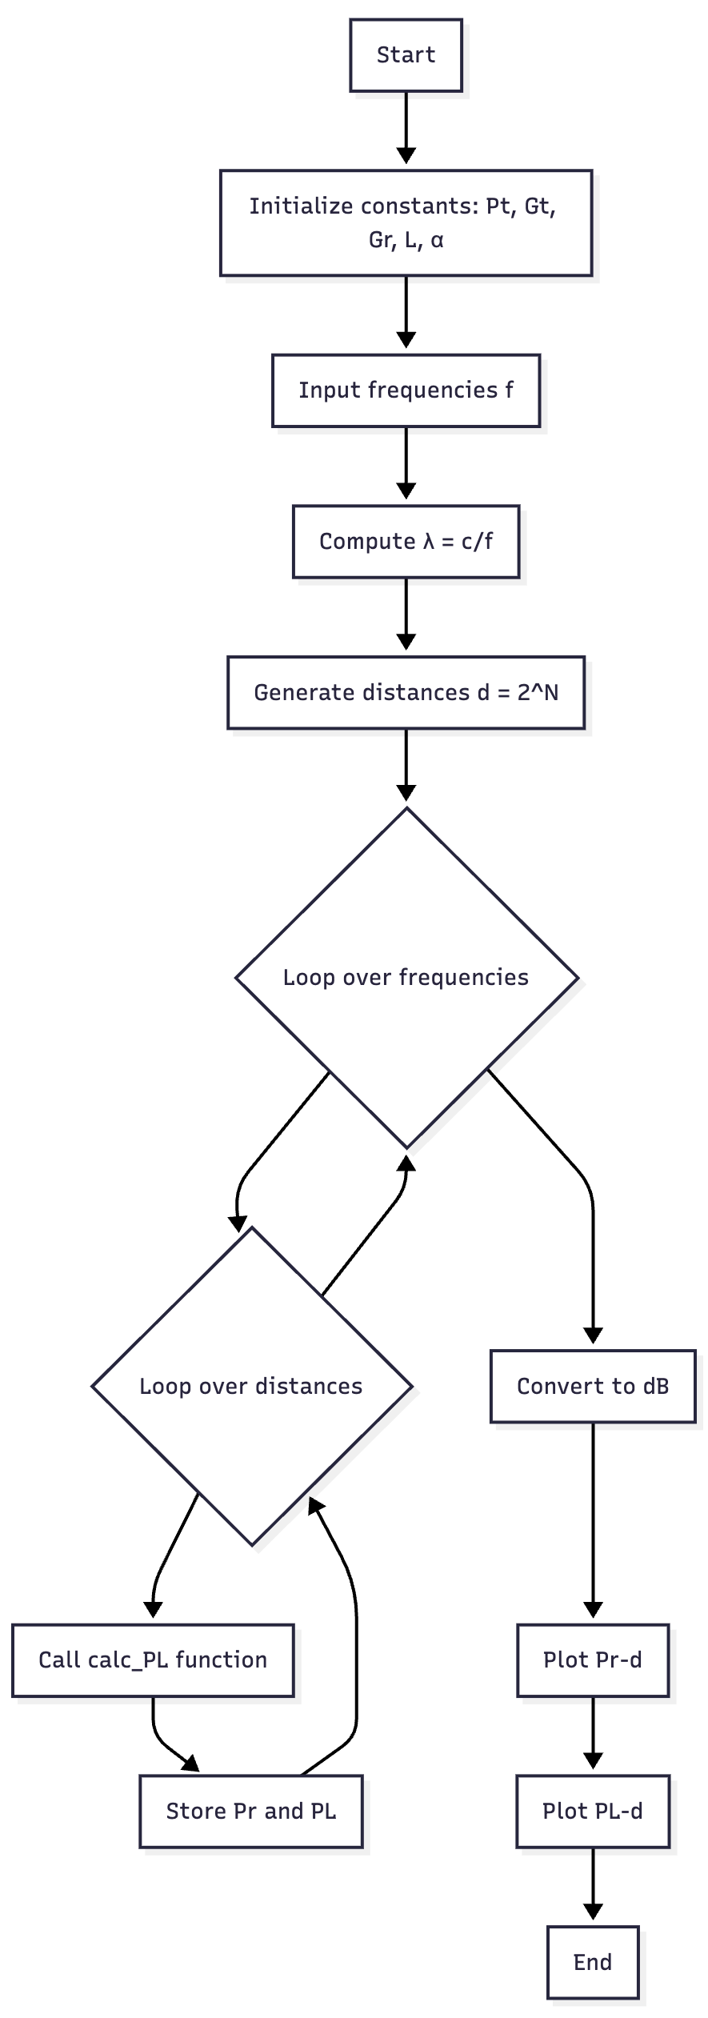
Path Loss Model: Flowchart
Visualizing the Logic
This flowchart illustrates the main script's logic for the path loss model.
Initialization: Set constants (Pt, Gt, Gr, L, α).
Inputs: Define frequencies (f) and distances (d).
Processing Loop: Iterate through each frequency and distance.
Function Call: Call `calc_PL` to compute Pr and PL for each point.
Output: Convert results to dB and generate plots.

Slide 5
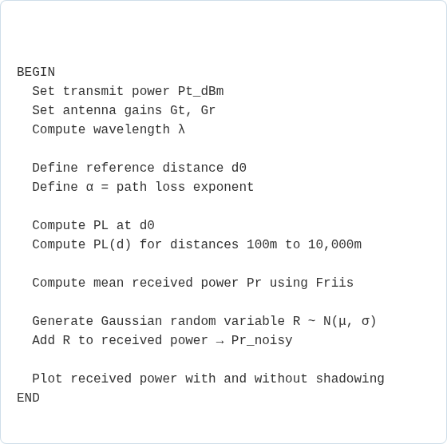
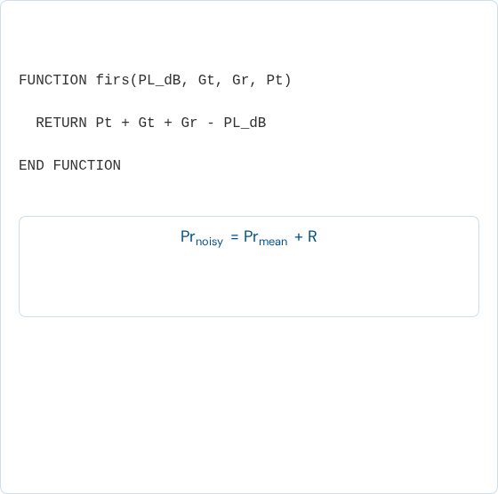
Shadowing Model: Pseudocode
Main Script (Shadowing)
Friis Function (dB)
where R is a Gaussian random variable, R ~ N(μ, σ)

Slide 6
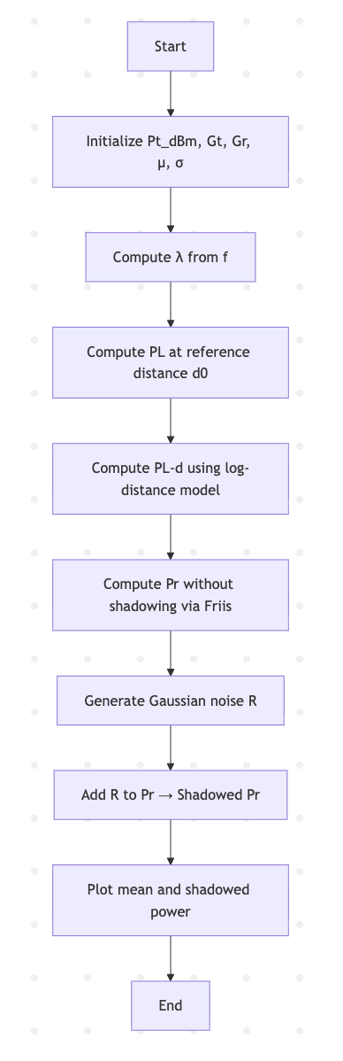
Shadowing Model: Flowchart
This flowchart details the shadowing model, which adds random variations to simulate real-world obstacles.
Initialization: Set constants (Pt, Gt, Gr, μ, σ).
Path Loss: Compute PL using the log-distance model.
Mean Power: Calculate the mean received power (Pr) using the Friis equation.
Noise Generation: Generate Gaussian noise (R) to model shadowing.
Final Output: Add noise to the mean power and plot both signals.

Slide 7

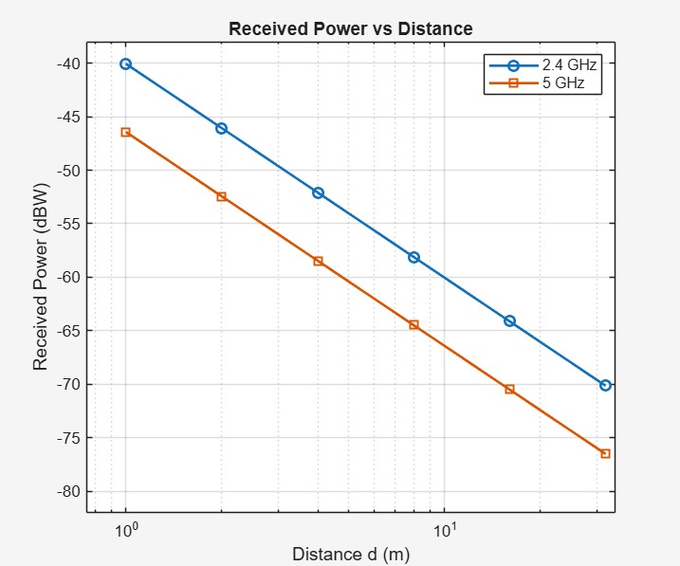
Expected Results
Visualizing the Models
The final plots will demonstrate the core concepts:
Path Loss Plot: Will show signal power (Pr) decreasing linearly on a dB scale as the log of distance increases.
Frequency Comparison: Higher frequencies (e.g., 5 GHz) will show greater path loss than lower frequencies (e.g., 900 MHz).
Shadowing Plot: Will show the "noisy" received power fluctuating around the mean, representing the impact of shadowing.

Slide 8
